Slide 1


Anastasiia Trofymova
01/23/2025

Slide 2

Outline
Executive Summary
Introduction
Methodology
Results
Conclusion
Appendix

Slide 3
Executive Summary
Web Scraping
Utilized web scraping techniques to extract SpaceX launch data from an online source.
Processed and stored the collected data for analysis and reporting.
Data Collection Using APIs
Accessed SpaceX data through APIs to collect detailed information about launches.
Implemented data normalization and structured the collected information for further analysis.
Data Wrangling
Cleaned and preprocessed SpaceX data to handle missing values, inconsistencies, and redundancies.
Transformed data into a structured format suitable for analytical and machine learning tasks.
Exploratory Data Analysis (SQL)
Leveraged SQL queries to perform initial exploratory analysis of launch data.
Identified patterns and key metrics, such as success rates and payload trends.
Exploratory Data Analysis (Visualization)
Conducted visual data analysis using Python libraries like Matplotlib and Seaborn.
Visualized relationships between launch outcomes, payload mass, orbit types, and other variables.
Launch Site Location Analysis
Analyzed geographical launch site data to evaluate site-specific factors affecting launch success.
Used geospatial visualizations to illustrate site effectiveness and distribution.
Machine Learning Prediction
Developed a classification model to predict the success of SpaceX launches.
Selected and evaluated machine learning algorithms for optimal performance.
Assessed model accuracy and derived actionable insights from predictions.

Slide 4
Executive Summary
Summary of All Results
Extracted comprehensive datasets through web scraping and APIs for analysis.
Identified significant trends, such as correlations between payload mass, orbit type, and launch success.
Visualized key patterns and insights using SQL and advanced visualization techniques.
Demonstrated the importance of launch site selection and its impact on mission outcomes.
Built and evaluated a machine learning model with high accuracy to predict launch success.
Delivered actionable insights for SpaceX’s operational strategy, enabling data-driven decision-making for future launches.

Slide 5
Introduction
Project Background and Context
SpaceX has revolutionized the space industry with its reusable rocket technology, making space exploration more cost-effective and accessible.
The project aims to analyze SpaceX launch data to derive insights and support data-driven decisions for optimizing launch success and operational strategies.
This study leverages data science techniques such as web scraping, API integration, data wrangling, exploratory analysis, and machine learning to uncover valuable insights.
Problems You Want to Find Answers
What factors influence the success of a SpaceX launch?
How do payload mass, orbit type, and other variables affect launch outcomes?
Which launch sites are the most effective in ensuring successful missions?
Are there geographical or operational factors contributing to differences in success rates?
Can we predict the success of a SpaceX launch based on historical data?
How accurately can machine learning models forecast launch outcomes?

Slide 6

Section 1

Slide 7
Methodology
Data Collection Methodology
Web Scraping:
Extracted SpaceX launch data from publicly available online sources using Python web scraping libraries.
API Integration:
Collected additional detailed launch data from SpaceX's API, including payload, orbit, and mission outcome information.
Data Wrangling
Cleaned and preprocessed raw data to handle:
Missing values.
Data inconsistencies.
Redundancies.
Transformed the dataset into a structured format for further analysis.
Data Processing
Normalized and standardized data fields for consistency.
Created derived columns and features relevant to analysis and predictions (e.g., success/failure indicators, payload categories).
Exploratory Data Analysis (EDA)
SQL-Based Analysis:
Used SQL queries to identify trends, calculate success rates, and analyze payload impacts.
Visualization:
Applied Python visualization libraries (Matplotlib, Seaborn) to uncover patterns and relationships in the data.

Slide 8
Methodology
Interactive Visual Analytics
Folium:
Created geospatial visualizations to analyze launch site performance and geographic distribution.
Plotly Dash:
Built interactive dashboards to dynamically explore key insights and trends.
Predictive Analysis Using Classification Models
Model Building:
Developed machine learning models to classify launch success.
Explored algorithms such as Logistic Regression, Decision Trees, and Support Vector Machines.
Model Tuning:
Fine-tuned hyperparameters to optimize model performance.
Applied cross-validation techniques to ensure robustness.
Model Evaluation:
Evaluated models using metrics like accuracy, precision, recall, and F1-score.
Selected the best-performing model for predicting SpaceX launch outcomes.

Slide 9
Data Collection
Data Collection Process
Web Scraping:
Extracted SpaceX launch data from public online sources using Python libraries such as BeautifulSoup and requests.
Parsed the HTML content to retrieve relevant information, including launch dates, payloads, orbit types, and mission outcomes.
API Integration:
Accessed SpaceX's official API to retrieve detailed and structured data on launches.
Fetched additional information, such as rocket types, core reusability, payload masses, and customer details.
Data Consolidation:
Merged data from web scraping and API into a unified dataset for consistency.
Ensured data completeness by cross-referencing multiple sources.
Data Storage:
Stored the collected data in structured formats (e.g., CSV, SQL databases) for easy access and processing during analysis.

Slide 10
Data Collection
Official SpaceX API
Public Web Sources
Data Consolidation
Unified Dataset (CSV/SQL)
API Integration
Web Scraping
JSON Responses
Raw HTML Data
Normalization
Parsing & Cleaning
Additional Launch Data
Structured Launch Data

Slide 11
Data Collection – SpaceX API
Utilized SpaceX RESTful API to retrieve structured data on past launches, rockets, payloads, and missions.
The API provided a reliable and efficient method to gather detailed information directly from SpaceX’s database.
Key focus: extracting launch details such as launch site, payload mass, orbit type, and mission success.
SpaceX API Documentation
CSV/Database
Identify Endpoints
Data Storage
List of Relevant Endpoints
Tabular Data
Client (Python requests)
Data Normalization
Send API Request
Extracted Key Fields
https://github.com/Arsiry/ibm-professional-certificates/blob/main/data-science-capstone-project/lab-2-spacex-data-collection-api.ipynb
JSON Response
Nested JSON Parsing

Slide 12
Data Collection - Scraping
Web scraping was used to collect data from publicly available online sources.
The goal was to extract SpaceX launch data such as launch dates, mission names, rocket types, and outcomes.
Implemented Python libraries like BeautifulSoup and requests to automate the data extraction process.
Target Website
Analyze HTML Structure
HTTP Request
HTML Content
Parse with BeautifulSoup
Tabular Format (CSV)
https://github.com/Arsiry/ibm-professional-certificates/blob/main/data-science-capstone-project/lab-1-webscraping.ipynb
Extract Relevant Data
Clean and Structure Data

Slide 13
Data Wrangling
Data wrangling is the process of cleaning, transforming, and structuring raw data to make it ready for analysis.
Focused on handling missing values, fixing inconsistencies, and creating derived fields to enhance the dataset.
Raw Data
Inspect Data
Identify Issues
Cleaned Data (CSV/SQL)
Handle Missing Values
https://github.com/Arsiry/ibm-professional-certificates/blob/main/data-science-capstone-project/lab-3-spacex-data-wrangling.ipynb
Correct Data Types
Normalize and Scale
Fix Inconsistencies
Create Derived Features

Slide 14
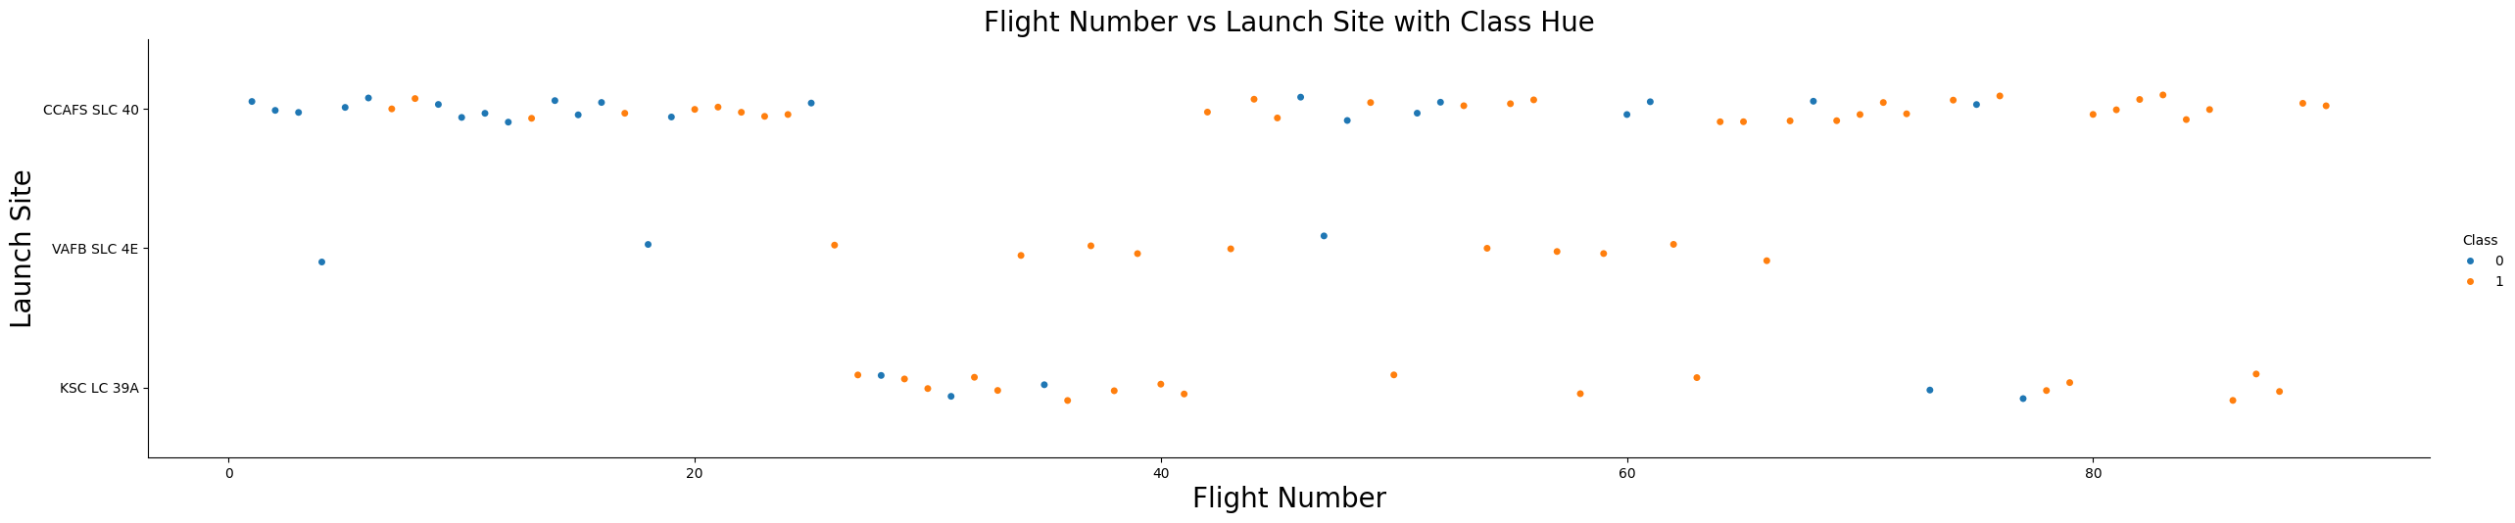
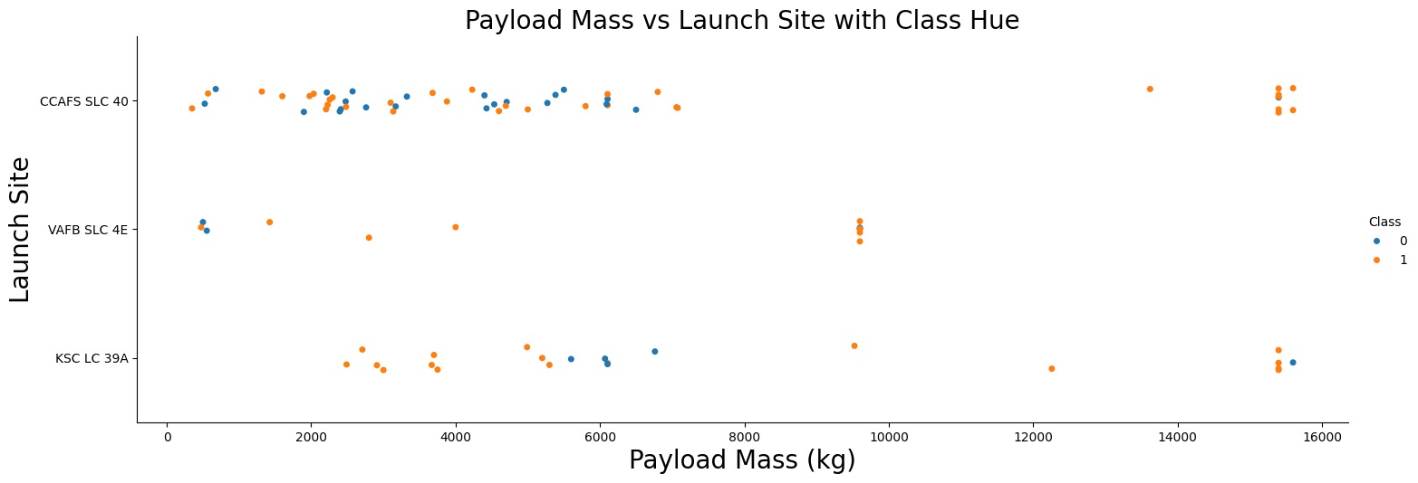
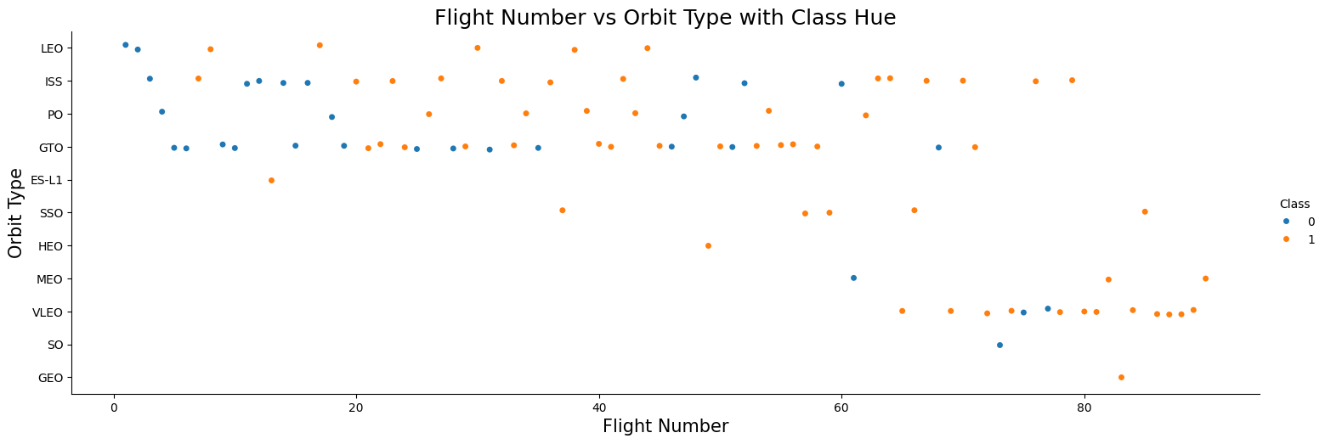
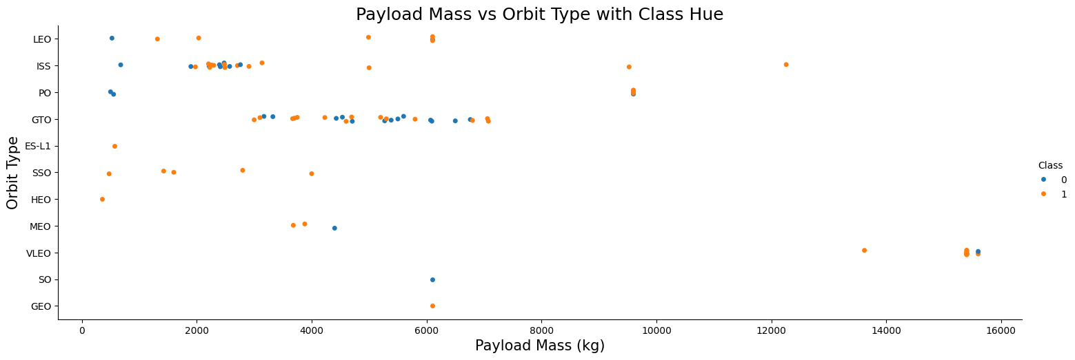
EDA with Data Visualization
https://github.com/Arsiry/ibm-professional-certificates/blob/main/data-science-capstone-project/lab-5-eda-dataviz.ipynb
Relationship between Flight Number and Launch Site
Relationship between Payload and Launch Site
Relationship between FlightNumber and Orbit type
The relationship between Payload and Orbit type

Slide 15
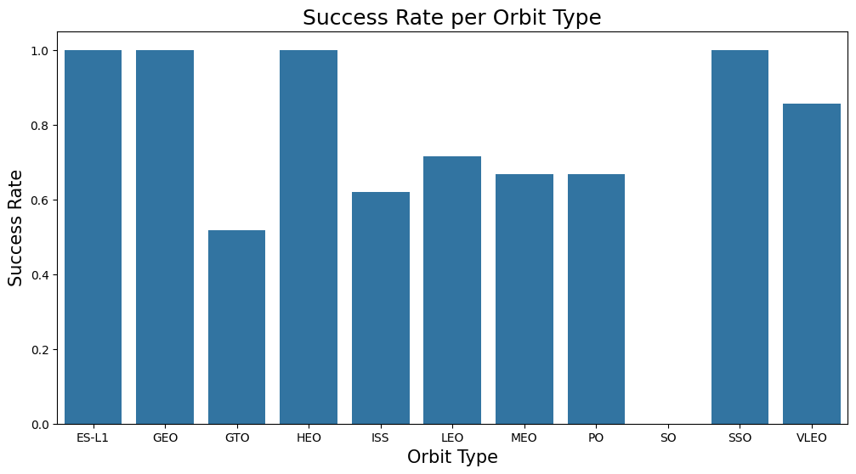
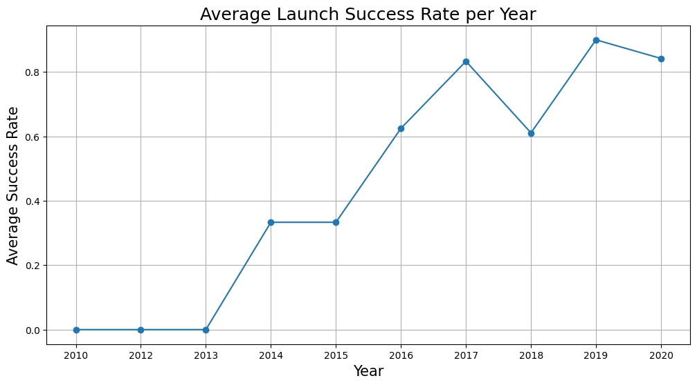
EDA with Data Visualization
https://github.com/Arsiry/ibm-professional-certificates/blob/main/data-science-capstone-project/lab-5-eda-dataviz.ipynb
Relationship between success rate of each orbit type
The launch success yearly trend

Slide 16
EDA with SQL
Using bullet point format, summarize the SQL queries you performed
https://github.com/Arsiry/ibm-professional-certificates/blob/main/data-science-capstone-project/lab-4-eda-sql.ipynb

Slide 17
Build an Interactive Map with Folium
Summarize what map objects such as markers, circles, lines, etc. you created and added to a folium map
Explain why you added those objects
https://github.com/Arsiry/ibm-professional-certificates/blob/main/data-science-capstone-project/lab-6-launch-site-location.ipynb

Slide 18
Predictive Analysis (Classification)
Summarize how you built, evaluated, improved, and found the best performing classification model
You need present your model development process using key phrases and flowchart
https://github.com/Arsiry/ibm-professional-certificates/blob/main/data-science-capstone-project/lab-7-SpaceX-ml-prediction.ipynb

Slide 19
Results
Exploratory data analysis results
Interactive analytics demo in screenshots
Predictive analysis results

Slide 20

Section 2

Slide 21
Flight Number vs. Launch Site
Show a scatter plot of Flight Number vs. Launch Site
Show the screenshot of the scatter plot with explanations

Slide 22
Payload vs. Launch Site
Show a scatter plot of Payload vs. Launch Site
Show the screenshot of the scatter plot with explanations

Slide 23
Success Rate vs. Orbit Type
Show a bar chart for the success rate of each orbit type
Show the screenshot of the scatter plot with explanations

Slide 24
Flight Number vs. Orbit Type
Show a scatter point of Flight number vs. Orbit type
Show the screenshot of the scatter plot with explanations

Slide 25
Payload vs. Orbit Type
Show a scatter point of payload vs. orbit type
Show the screenshot of the scatter plot with explanations

Slide 26
Launch Success Yearly Trend
Show a line chart of yearly average success rate
Show the screenshot of the scatter plot with explanations

Slide 27
All Launch Site Names
Find the names of the unique launch sites
Present your query result with a short explanation here

Slide 28
Launch Site Names Begin with 'CCA'
Find 5 records where launch sites begin with `CCA`
Present your query result with a short explanation here

Slide 29
Total Payload Mass
Calculate the total payload carried by boosters from NASA
Present your query result with a short explanation here

Slide 30
Average Payload Mass by F9 v1.1
Calculate the average payload mass carried by booster version F9 v1.1
Present your query result with a short explanation here

Slide 31
First Successful Ground Landing Date
Find the dates of the first successful landing outcome on ground pad
Present your query result with a short explanation here

Slide 32
Successful Drone Ship Landing with Payload between 4000 and 6000
List the names of boosters which have successfully landed on drone ship and had payload mass greater than 4000 but less than 6000
Present your query result with a short explanation here

Slide 33
Total Number of Successful and Failure Mission Outcomes
Calculate the total number of successful and failure mission outcomes
Present your query result with a short explanation here

Slide 34
Boosters Carried Maximum Payload
List the names of the booster which have carried the maximum payload mass
Present your query result with a short explanation here

Slide 35
2015 Launch Records
List the failed landing_outcomes in drone ship, their booster versions, and launch site names for in year 2015
Present your query result with a short explanation here

Slide 36
Rank Landing Outcomes Between 2010-06-04 and 2017-03-20
Rank the count of landing outcomes (such as Failure (drone ship) or Success (ground pad)) between the date 2010-06-04 and 2017-03-20, in descending order
Present your query result with a short explanation here

Slide 37

Section 3

Slide 38
<Folium Map Screenshot 1>
Replace <Folium map screenshot 1> title with an appropriate title
Explore the generated folium map and make a proper screenshot to include all launch sites’ location markers on a global map
Explain the important elements and findings on the screenshot

Slide 39
<Folium Map Screenshot 2>
Replace <Folium map screenshot 2> title with an appropriate title
Explore the folium map and make a proper screenshot to show the color-labeled launch outcomes on the map
Explain the important elements and findings on the screenshot

Slide 40
<Folium Map Screenshot 3>
Replace <Folium map screenshot 3> title with an appropriate title
Explore the generated folium map and show the screenshot of a selected launch site to its proximities such as railway, highway, coastline, with distance calculated and displayed
Explain the important elements and findings on the screenshot

Slide 41

Section 4

Slide 42
<Dashboard Screenshot 1>
Replace <Dashboard screenshot 1> title with an appropriate title
Show the screenshot of launch success count for all sites, in a piechart
Explain the important elements and findings on the screenshot

Slide 43
<Dashboard Screenshot 2>
Replace <Dashboard screenshot 2> title with an appropriate title
Show the screenshot of the piechart for the launch site with highest launch success ratio
Explain the important elements and findings on the screenshot

Slide 44
<Dashboard Screenshot 3>
Replace <Dashboard screenshot 3> title with an appropriate title
Show screenshots of Payload vs. Launch Outcome scatter plot for all sites, with different payload selected in the range slider
Explain the important elements and findings on the screenshot, such as which payload range or booster version have the largest success rate, etc.

Slide 45

Section 5

Slide 46
Classification Accuracy
Visualize the built model accuracy for all built classification models, in a bar chart
Find which model has the highest classification accuracy

Slide 47
Confusion Matrix
Show the confusion matrix of the best performing model with an explanation

Slide 48
Conclusions
Point 1
Point 2
Point 3
Point 4
…

Slide 49
Appendix
Include any relevant assets like Python code snippets, SQL queries, charts, Notebook outputs, or data sets that you may have created during this project

Slide 50


